Slide 1
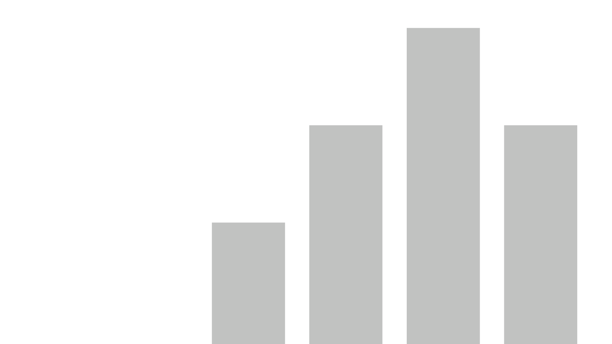


6.Heart Disease Diagnostic Analysis
View in Power BI
Last data refresh:
6/25/2024 11:18:01 AM UTC
Downloaded at:
6/25/2024 11:20:51 AM UTC

Slide 2
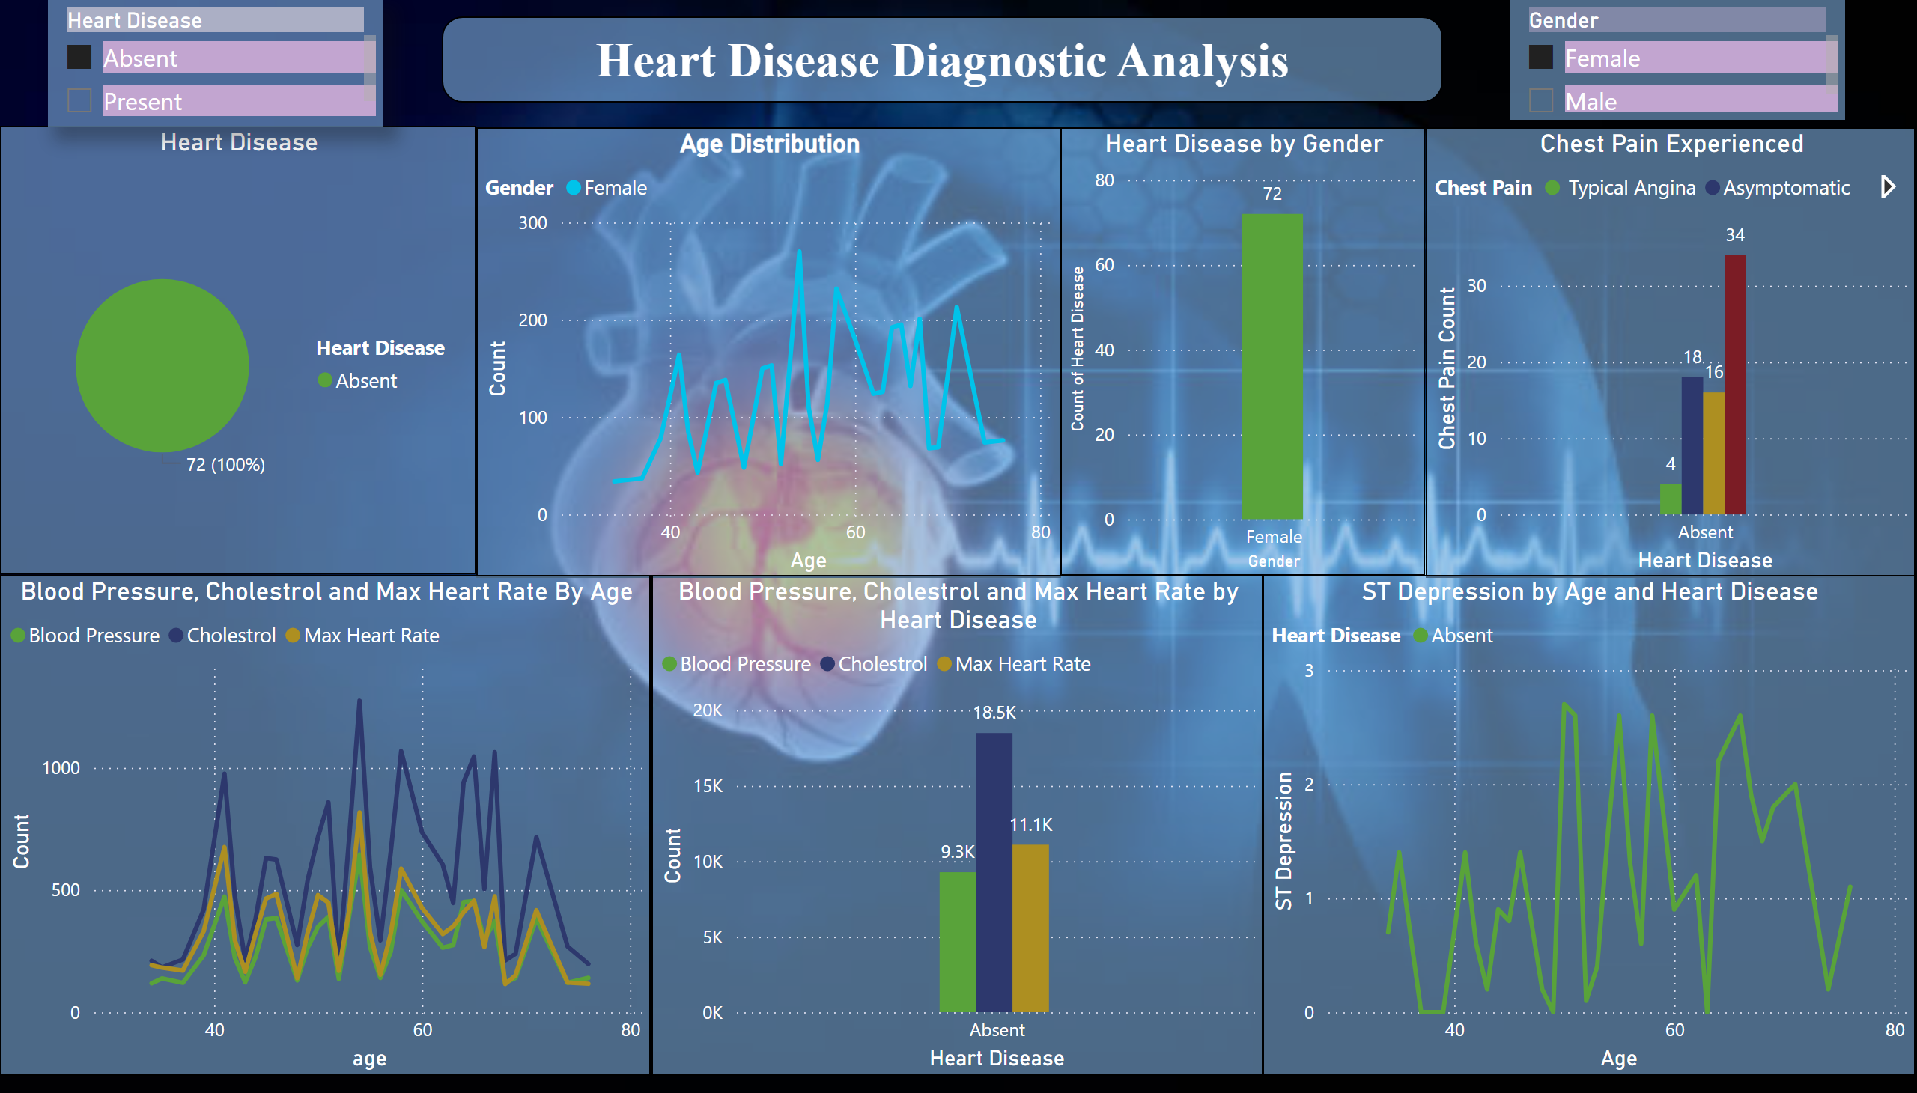
Heart Disease Analysis
Notes:
Heart Disease by Gender
No alt text provided
Heart Disease
No alt text provided
Age Distribution
No alt text provided
Chest Pain Experienced
No alt text provided
Blood Pressure, Cholestrol and Max Heart Rate By Age
No alt text provided
Blood Pressure, Cholestrol and Max Heart Rate by Heart Disease
No alt text provided
ST Depression by Age and Heart Disease
No alt text provided
slicer
No alt text provided
slicer
No alt text provided
textbox
No alt text provided

